Slide 1
Performance Measures of Database Types and Transformation Solutions in ETL Pipelines
Jeff Nguyen and Reannan McDaniel
Notes:
We are pleased to present a case study on Performance Measures of Database Types and Transformation Solutions in ETL Pipeline. I am Reannan and my partner for the case study is Jeff Nguyen.

Slide 2






Executive Summary
Purpose
Explain project motivations
What is Extract, Transform, and Load (ETL)?
ETL overview and explanation
State Hypotheses
Experiment Set-up and Methodology
Data
Experiment set-up
Metrics
Execution
Results
Conclusions
Notes:
Our objectives to cover are the Purpose, What is ETL, our hypotheses, the experiment set-up and methodology, the results and finally our conclusion.

Slide 3
Purpose
Identify storage and data transformation solutions that minimize resource usage.
Notes:
Compare the differences between MySQL and NoSQL; as well as Pandas and cuDF then identify storage and resource utilization.
Combinations used for this project:
MySQL – Pandas/cuDF – MySQL
NoSQL – Pandas/cuDF – NoSQL
We want to compare differences between MySQL vs. NoSQL; and Pandas vs. cuDF

Slide 4
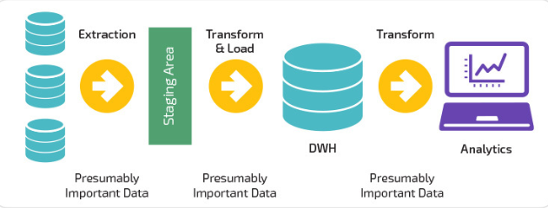
What is ETL?
Extraction, transformation, and loading is a process used to get raw data into a state that is easily accessible and useable.
Extraction
Extraction involves moving data from a database into a data transformation environment
Transformation
Transformation is the process used to prepare data for loading into a database
Loading
Loading takes transformed data and moves it into a data warehouse or data lake
Notes:
Extraction, transformation. loading or ETL is a process flow to input data into a state that is easily useable.
Extraction - moving data from one database into a storage area
Transformation - prepare data for data lake loading
Loading - transformed data is loaded into final database or data lake
This process can be demanding and may require larger amounts of resources as the volume of data increases.
More storage space
Man hours for ETL maintenance
-Transformation:
Systems require data to be in a certain form, the transformation step of ETL prepares that data for the target system
-Loading:
Loaded data may or may not be normalized based on business requirements
Data is usually extracted from a database into pandas, R, or other data manipulation environment
Several examples of 3rd party ETL processes are:
Informatic PowerCenter
Azure
Apache Camel/Kafka

Slide 5


What is ETL: Storage Solutions
MySQL
Open-source (free)
Web-based
Scalability
Data is presented in tables and rows.
MongoDB
Uses JSON-like documents
Open source
Scalability
Data is in collections
Notes:
There are many different storage solutions for both SQL and NoSQL. For the purposes of this case study we used MySQL and MongoDB. Both are open-source and are known for scalability. MySQL is a relational database management system where data is in tables and rows. MongoDB is uses JSON-like documents and data is in collections.
MySQL is a open-source, web-based, relational database management system initially released in 1995. MySQL is known for scalability – meaning it can be used for small or large datasets. MySQL is unique from other SQL RDBMS because it is open-source, or free.
MongoDB is a NoSQL database that uses JSON-like documents instead of entity tables like RDBMS. There is greater flexibility with scalability in NoSQL databases such as MongoDB. The data is displayed in collections.

Slide 6


What is ETL: Pandas & NVIDIA RAPIDS
Several packages exist for data manipulation and transformation, but for this project we will focus on python packages:
Pandas
This python package is designed for data manipulation
NVIDIA RAPIDS (cuDF)
NVIDIA RAPIDS is an open source suite of GPU optimized data manipulation
Notes:
There are also many packages that are available for data manipulation - we used Python Pandas and NVIDIA RAPIDS (cuDF). Pandas is one of the more popular packages used for data manipulation. NVIDIA RAPIDS is open-source and has many libraries used for data manipulation.
Pandas’ inbuilt functions that allow for data to quickly be cleaned, modified, and analyzed
- Used in a python environment
Common data manipulation tool like
Dplyr
Open source Python data manipulation library
Contains many inbuilt functions
Allows users to take advantage of a GPU’s thread count and high bandwidth dedicated memory
cuDF is a data manipulation library
NVIDIA RAPIDS is an open-source suite of data manipulation and machine learning libraries
Optimized for use with GPUs
Syntax is nearly identical to Pandas

Slide 7





Hypotheses
We expect MySQL to take longer in read/write operations compared to NoSQL
Transformations may take longer in NoSQL as there is a potential for duplicate data
cuDF will outperform Pandas in data transformation
Notes:
There are three focus points for our hypotheses;
We expect MySQL to take longer during read/write process compared to MongoDB
The transformation process may take longer in MongoDB as there may be duplicate data
cuDF will outperform pandas during the data transformation phase
Since the data is normalized, in MySQL we expect the transformation process to work faster than in NoSQL.
Modification of data in MySQL will occur in one location (a tabular relational database) for normalized data
Modification of data in NoSQL requires referencing multiple documents
However, the read write process would take more time in MySQL than NoSQL due to:
ACID compliant properties required in relational databases.
Note about cuDF
note

Slide 8
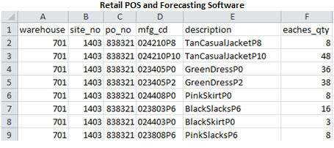
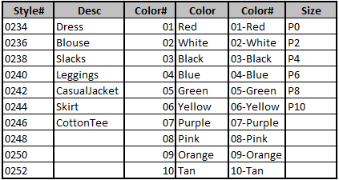
Experiment Set-up : Data
Kelly-Moore Paints Company provided data for this analysis
Transform 406 paint SKUs to SKUs for a women's boutique clothing line
The schema used is a combination of article type, color and size
Proprietary information was removed from the dataset
Notes:
Kelly-Moore Paints provided data and all proprietary information has been removed.
406 paint SKUs were transformed into women’s boutique clothing using a combination of article type, clothing and size. The data was then reverse engineered into its normal form during extraction and transformation phases.
Data needed to be reverse engineered into it’s normal form
This is done to test extraction and transformation phases of ETL
The data is generated from 2 sources
Retail Point of Sale
Forecasting software
The data is comprised of:
Order recommendations – at the site level
Actual sales – at the site level

Slide 9
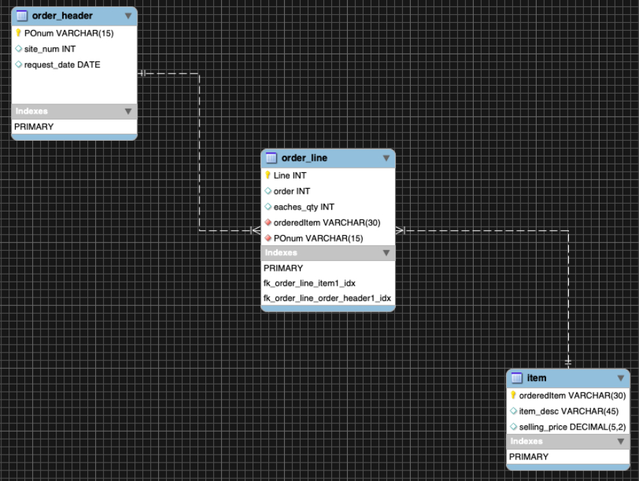
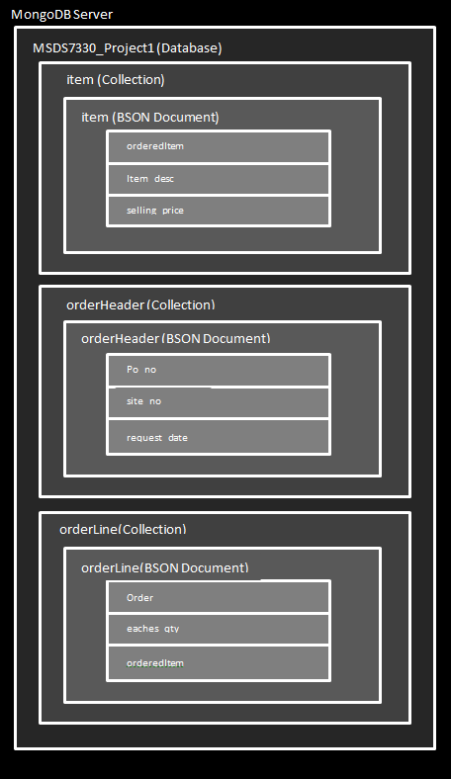
Experiment Set-up: Database Models
MongoDB
MYSQL
Notes:
Our MySQL model is made up of three entity tables that include order information, order line detail and item detail. Similarly our MongoDB model is comprised of a database, three collections (Item, order header and order line data) and finally the BSON documents or Key Valued Pairs.

Slide 10
Experiment set-up: Software
OS and Transformation | Extraction and Loading
Ubuntu 18.04 LTS | MongoDB 4.2
Python 3.7.0 | MongoDB Compass 1.20.5
Jupyter Notebook 6.0.3 | MySQL 8.0.19
Pandas 1.0.3 | MySQL Workbench 8.0.19
cuDF 0.8
Cuda Toolkit 10.2
Rstudio 1.2.5033
R 3.6.3
Notes:
The software used and open during the process was - MySQL Workbench and MongoDB Compass
For extraction and loading: Jupiter Notebook, pandas, cuDF and RStudio
For transformation we used Ubuntu, MongoDB and MySQL
and a few software applications running during each phase was two internet browsers, Excel and Zoom
Software Open During ETL
2 Internet Browser Tabs
DB Application
Excel
Zoom
File Explorer

Slide 11
Experiment set-up: Hardware
Hardware
AMD Ryzen 9 3900X
32GB RAM
NVIDIA 2070 Super
500GB NVME m.2 SSD
Notes:
The experiment was performed using the following hardware:
32G GB of RAM and NVIDIA 2070 Super to name a couple.
I would like to introduce Jeff who will provide our experiment set-up, methodology, results and conclusion.

Slide 12


Experiment Methodology
Measuring ETL Performance
Performance metrics such as: CPU usage, RAM usage, and time to execute operations will be captured
Metrics will be captured at each ETL step:
Notes:
CPU and RAM utilization, and elapsed time will be captured for each sample for each work load
There are a total of 720 rows of data with over 3600 datapoints

Slide 13
Experiment Methodology: Workloads
Item | Light | Medium | Heavy
Tables to Join | 1 | 2 | 3
Transformations | 1x String Modification | 1x String Modification 1x Calculated Column | 2x String Modification 1x Calculated Column
Notes:
For our testing we had two ETL combinations with varying workloads:
MySQL – Pandas/cuDF – MySQL
Mongo – Pandas.cuDF – Mongo
Both combinations have light, medium and heavy workloads
We wanted to compare transformation and database solutions to see which one took less resources
Light
Smallest table with 406 rows
One string transformation
Medium
Order_line and item talbes joined at 240K rows
One string transformation
One calculated column
Heavy
All tables joined (240K rows)
two string transformations
One calculated column price * quantity
All extraction, transformation, and loading scripts were handled using Python in Jupyter Notebook

Slide 14
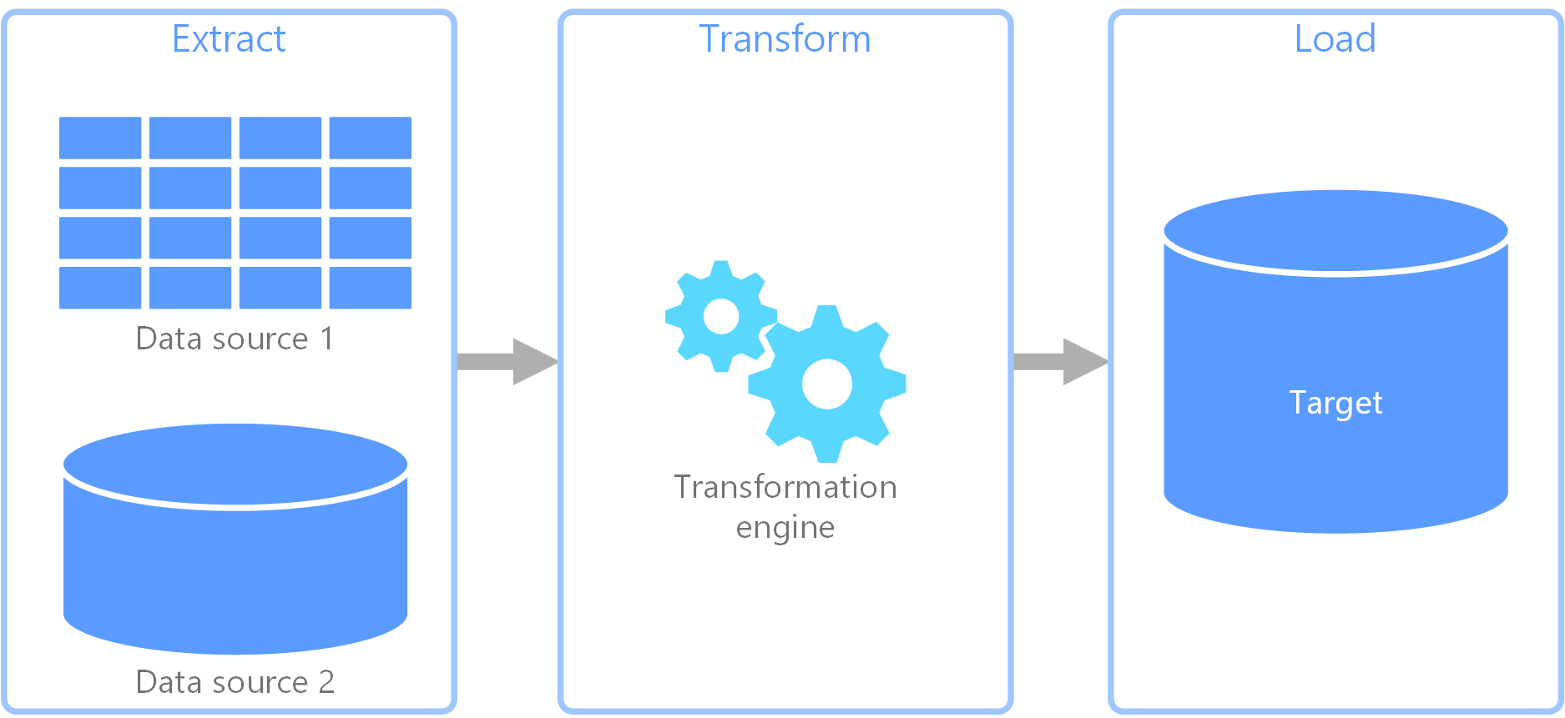
Experiment Methodology: Data capture
Data was captured sampled iteratively
A for loop was used to iterate through each ETL process with a 5 second break between samples to allow for the system to return to base utilization.
CPU and RAM base utilization were captured before process execution
(
n = 30
+
n = 60
+
n = 30
)
x 6 = 720
Notes:
For light, medium and heavy workloads:
30 samples were taken from extraction
60 samples were taken for transformation (pandas and cuDF)
30 samples were taken for loading
This sampling scheme was used for both MySQL ETL and MongoDB ETL
Sampling methodology:
Base CPU and RAM utilizations were taken right before a process was executed
Right afterwards a CPU and RAM utilization sample was taken
Base utilization subtracted from sample to get process utilization
Go over the use of the loop
5 Second break to allow computer to settle down
Start Process timer
Transformation scripts executed
CPU and RAM utilization captured
Timer stopped
CPU, RAM utilization, and elapsed time captured in a dataframe
Loop is repeated 29 more times
Data from previous iteration is over-written by new data for each iteration.
Photo cred: https://docs.microsoft.com/en-us/azure/architecture/data-guide/relational-data/etl

Slide 15



Experiment Execution: Problems encountered?
Setting up with Databases
Transferring data to and from databases
Installing Drivers for cuDF use
Notes:
Problems we encountered working on this project included:
Working with Databases
Setting up security settings: granting write privileges in MSQL for taking data in via scripts: using the data import wizard solved this quickly
Setting buffer length and packet sizes in MySQL to prevent time-outs
Transferring data to and from databases
- Understanding how to use, set up, and troubleshoot pandas functions
Installing Drivers for cuDF use
- Correctly installing drivers and CUDA toolkits – new to Ubuntu so system would not be stable at times
I’m excited to share the results on these following slides – we found some interesting

Slide 16
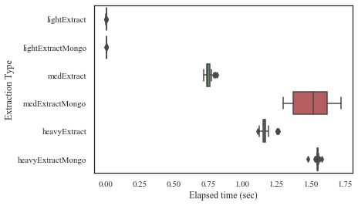
Results: Extraction
Extracting from MySQL can be faster than MongoDB
Extraction Elapsed Time
Notes:
For extraction:
Top plot is extraction elapsed time
Lower plot is CPU Utilization
MySQL is faster than MongoDB for medium and heavy workloads at the expense of CPU utilization
Go over Elapsed time
MySQL is roughly twice as fast as MongoDB for medium workload
MySQL is roughly 25% faster for heavy workloads
Go over CPU
MongoDB for medium and heavy work loads use the CPU slightly less than MySQL
Light workloads for both databases has a lot of variation
RAM Utilizations were pretty similar for all workloads

Slide 17
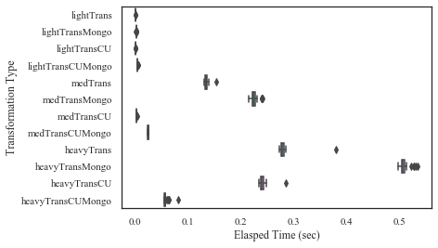
Results: Transformation
cuDF shows significantly faster transformations for some work loads
Transformation Elapsed Time
Notes:
For transformation:
The top plot is elapsed time, the lower plot is CPU utilization
cuDF outperformed pandas by a large margin
Data extracted from MySQL was al transformed more rapidly than NoSQL data
Mongo tables were joined in transformation environment
All documents in MongoDB are by default “objects”
Data types needed to be cast to documents
Go Over Elapsed Time
Data extracted from MySQL appears to get transformed more rapidly compared to MongoDB
The exception is the heavy cuDF transformation
cuDF transformations are several times faster compared to pandas transformation
Go Over CPU utilization
For Medium and light workloads the CPU utilization is negative as the operations took less time than the original base reading – this could be remedied by taking the absolute value
RAM Utilizations were pretty similar for all workloads

Slide 18
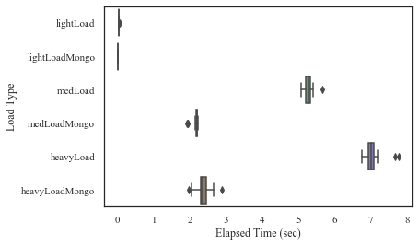
Results: Loading
MongoDB is significantly faster for loading Data
Load Elapsed Time
Notes:
For loading:
The top plot is elapsed time, the lower plot is RAM utilization
MongoDB is vastly faster than MySQL in loading
RAM utilization for MongoDB was less than MySQL for Medium and Heavy workloads
Go Over Elapsed Time
Mongo is at least 3 times as fast as MySQL in loading for medium and heavy workloads
Go Over RAM utilization
- MySQL took more RAM resources for medium and heavy workloads

Slide 19
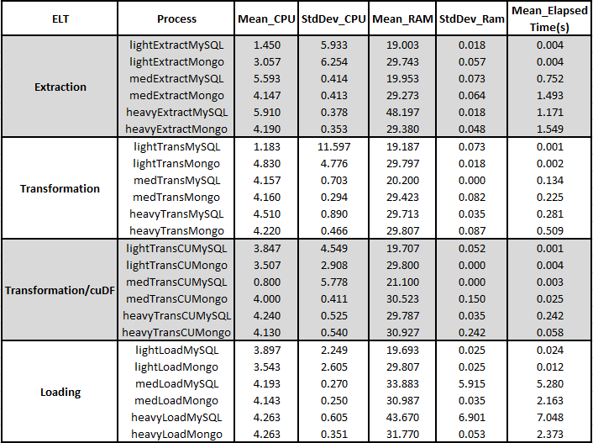
Statistics
Extraction: Elapsed time and CPU
The mean elapsed time for medium and heavy work loads are faster in MySQL than MongoDB
CPU utilization is 8.5% better for the medium work load and 27.5% better for the heavy work load in MongoDB – while MySQL performed 33.9% better in the light work load
Transformation: pandas and cuDF
For medium and heavy workloads cuDF out preforms pandas by a large margin in both MySQL and MongoDB
Loading: RAM usage
Statistically MongoDB out preformed MySQL in the medium workload by 25.9% and 29.1% in the heavy workload
Notes:
Extraction:
MySQL is faster for medium and heavy workloads
But MongoDB takes less CPU resources for medium and heavy
Transformation
cudDF outperforms Pandas by a large margin for data extracted from both MySQL and MongoDB
Comes at a very slight expense to RAM
Up to 4x faster for heavy workloads
Loading
MongoDB is at least 2x as fast as MySQL in loading for our workloads

Slide 20

Conclusions
MySQL outperformed MongoDB in read operations for medium and heavy workloads and they performed the same for light workloads.
Transformations took more time in MongoDB for data extraction compared to MySQL.
cuDF outperformed pandas in all workloads for both MySQL and MongoDB
Notes:
cuDF can speed up your transformations, freeing up the CPU, but at the expense of RAM
MySQL is faster with Extractions
But MongoDB is faster with Loading
Thank you everyone for being here
We hope these findings provide some useful information that can possibly save you some time
At this time we will take questions

